Slide 1
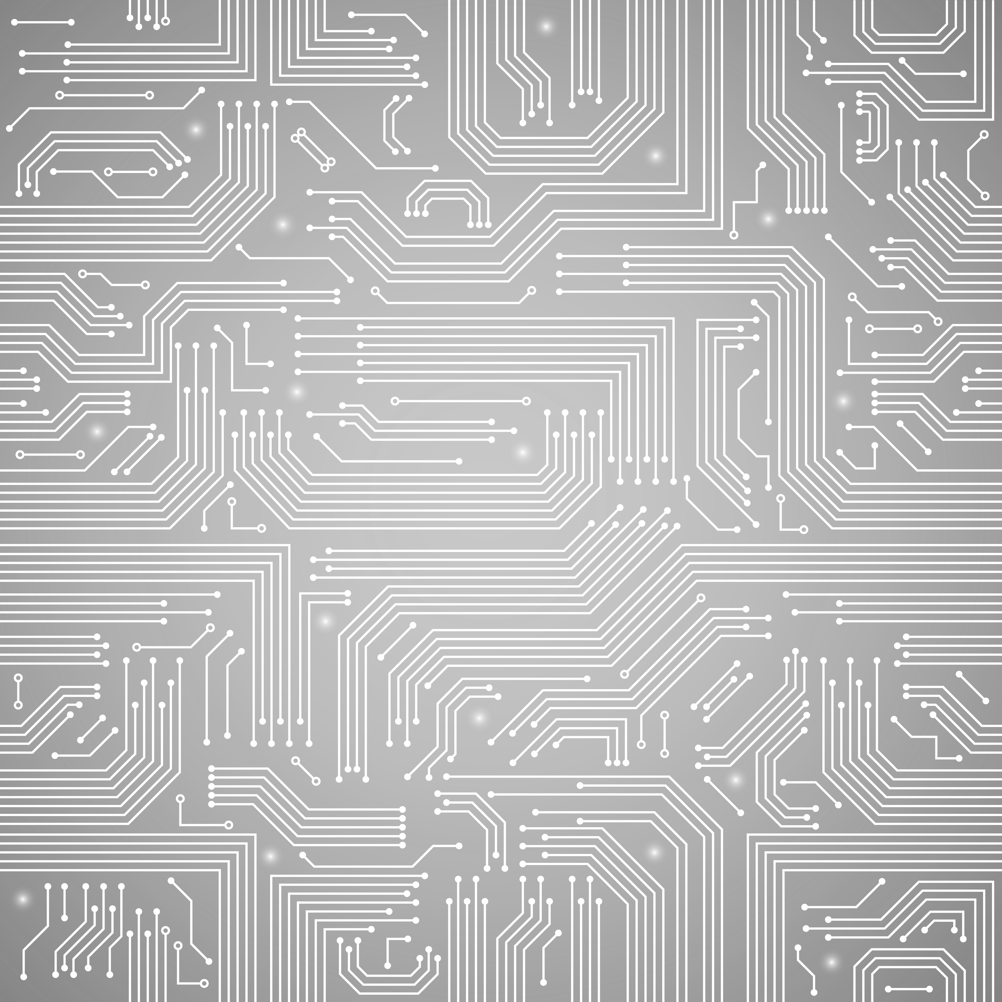
AUSF
UDR
NRF
CONTROL PLANE
AMF
SMF
UDM
UPF
USER PLANE
Notes:
PLANES

Slide 2
AUSF
UDR
NRF
AMF
SMF
UDM
UPF
Notes:
AMF SBA

Slide 3
NRF
AUSF
UDM
SMF
AMF
SMF
AMF
Notes:
AMF RBA

Slide 4
AUSF
UDR
NRF
AMF
SMF
UDM
UPF
Notes:
SMF SBA

Slide 5
UDM
NRF
SMF
UPF
AMF
Notes:
SMF RBA

Slide 6
AUSF
UDR
NRF
AMF
SMF
UDM
UPF
Notes:
NRF

Slide 7
UDR
NRF
AMF
SMF
UDR
AUSF
UDM
Notes:
NRF RBA

Slide 8
AUSF
UDR
NRF
AMF
SMF
UDM
UPF
Notes:
AUSF

Slide 9
NRF
AUSF
AMF
UDM
Notes:
AUSF RBA

Slide 10
AUSF
UDR
NRF
AMF
SMF
UDM
UPF
Notes:
UDM

Slide 11
NRF
UDR
AUSF
UDM
AMF
SMF
Notes:
UDM RBA

Slide 12
AUSF
UDR
NRF
AMF
SMF
UDM
UPF
Notes:
UDR

Slide 13
NRF
UDR
UDM
NRF
Notes:
UDR RBA

Slide 14
AUSF
UDR
NRF
AMF
SMF
UDM
UPF
Notes:
UPF

Slide 15
SMF
UPF
Notes:
UPF RBA

Slide 16
Notes:
UE -> RAN

Slide 17
Notes:
RAN -> Core

Slide 18
Notes:
Core -> RAN

Slide 19
Notes:
RAN -> DN

Slide 20
Notes:
UE

Slide 21
Notes:
RAN

Slide 22
Notes:
Core

Slide 23
Notes:
DN

